Slide 1
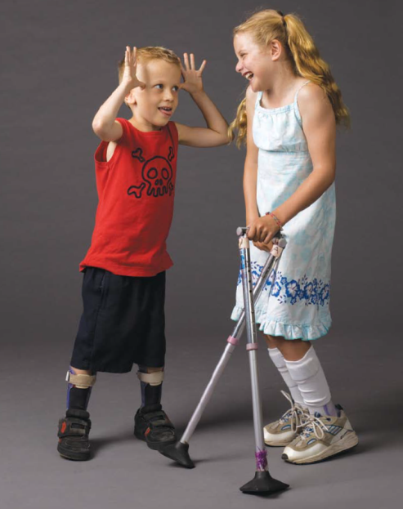
Outcome measures in CP
Notes:
Motor function can be reliably measured using the gross motor function measure and classified using the gross motor functional
classification system

Slide 2
Outcome measures
Specific instruments which are reliable and valid - preferred to document progress or improvement over time in a specified health condition - CP
Most of the outcome assessments are based on domains of functioning and health [ICF] which show changes upon intervention , change in condition over time -
Notes:
There is an international framework which guides the standard development of outcome measure – WHO – iCF
Which classifies human functioning in terms of body structurre body function , activity and participation
Every human participates in society when the all the activites enable a person to participate . For this all the body structurres function in unison to produce and activity
how ever there may be some factors which are extrinsic to human bodies which can enable , facilitate or restrict participation - theses are environmental facotrs , barriers
Interevntion in any domain may improve the ultimate goal of living the life with quality ---- Most of the chronic diseases -

Slide 3
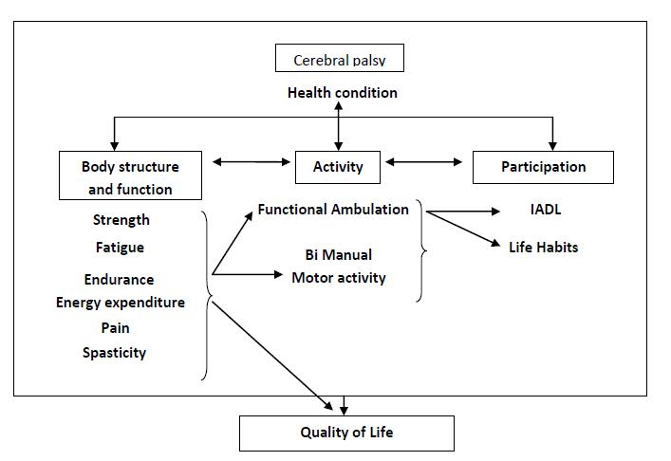

Slide 4
ICF and its use
To describe functioning and disability from a multidimensional perspective

Slide 5
ICF and its use
To examine associations between functions within and between the components
To investigate the influence of the environment and the contribution of personal factors on everyday functioning

Slide 6
The health condition in question is cerebral palsy

Slide 7
Classification of CP
Body function
Activity
Type of motor
impairment
  spastic
  dyskinetic
Topographical
distribution
  hemiplegia
  diplegia
  quadriplegia
Severity of gross motor
limitations (GMFCS)
  level I (least limitations)
  to
  level V (most limitations)
Notes:
Physiologically the impairments are

Slide 8
ICF components and measures
ICF components | Variables | Measures
Body Functions & Structures | Muscle tone Range of motion Selective motor control Strength Energy expenditure Fatigue Endurance Pain | Modified Ashworth scale Goniometry, SAROMM Selective Motor Control scale Functional strength testing , MMT, Dynamometer, Isokinetic EEI and Oxygen consumption MDFS (PedsQL) Distance covered , No. of repetitions VAS,
Activities | Capacity to perform daily activities Performance | PEDI; Functional Skills scale, GMFM-66 PODCI
Participation | Performance in daily life activities | LIFE- H, IADL,
Environmental Factors | Type and extent of modifications Impact of modifications | PEDI: Modifications scale Likert scale
Personal Factors | Gestational age Age | Questionnaire

Slide 9
ICF components and measures
ICF components | Variables | Measures
Participation | Performance in daily life activities | LIFE- H, IADL,
Environmental Factors | Type and extent of modifications Impact of modifications | TERRAINS PEDI: Modifications scale Likert scale MQE
Personal Factors | Gestational age Age | Questionnaire

Slide 10
Examination of CP should follow the pattern of ICF
Systematic method to determine causative factor from participation restriction
Provides systematic method for intervention to achieve the goal to enable CP to participate in daily life

Slide 11
The physical examination in CP

Slide 12
ICF components and measures
ICF components | Variables | Measures
Body Functions & Structures | Muscle tone Range of motion Selective motor control Strength Energy expenditure Fatigue Endurance Pain | Modified Ashworth scale Tardieu scale Goniometry Selective Motor Control scale Functional strength testing , MMT, Dynamometer, Isokinetic PCI and Oxygen consumption MDFS (PedsQL) Distance covered , No. of repetitions VAS,
Activities | Capacity to perform daily activities Performance | PEDI; Functional Skills scale, GMFM-66 PODCI
Participation | Performance in daily life activities | LIFE- H, IADL,
Environmental Factors | Type and extent of modifications Impact of modifications | PEDI: Modifications scale Likert scale
Personal Factors | Gestational age Age | Questionnaire

Slide 13
physical examination
Information collected is based on static responses
Whereas functional activities, such as walking, are dynamic

Slide 14
Medical history
Collection of information regarding birth history
Developmental milestones
Associated problems
Interventions
Functional skills

Slide 15
Muscle tone assessment

Slide 16
Particularly in CP
Hypertonia - can be caused by spasticity, dystonia, rigidity, or a combination of these features
Resting muscle tone can be influenced by the degree of cooperation, apprehension, or excitement present in the patient as well as the position during the assessment

Slide 17
Sanger and colleagues recommend a process:
By using a standard process for evaluation, the consistency and completeness of tone abnormality documentation improves

Slide 18
Palpate the muscle
Determine if there is a muscle contracture at rest
Move the limb slowly to assess the available passive ROM
Move the limb through the available range at different speeds
Assess the presence or absence of a catch and how this catch varies with a variety of speeds
Change the direction of motion of the joint at various speeds and assess how the resistance changes
Observe the limb/joint while asking the patient to move the same joint on the contralateral side

Slide 19
Spastic CP
Above a speed threshold (spastic catch) - resistance to externally imposed movement rises rapidly
The Ashworth scale, modified Ashworth scale, Tardieu scale, and an isokinetic dynamometer in conjunction with surface electromyography are methods used to assess severity of spastic hypertonia

Slide 20
Tone - MAS
0 – no increase in tone
1 slight increase in tone ( catch and release)
1+ slight increase in tone (resistance through less than half the range
2 more marked resistance but still easily moved
3 considerable increase in tone – passive movement difficult
4 Joint rigid
(Bohannon et al , 1987)
Notes:
Better to report tone in terms of MAS , spasticity in terms of Tardieu - better indication of dynamic spasticity

Slide 21
spasticity

Slide 22
Spasticity is a velocity-dependent resistance of a muscle to stretch

Slide 23
We therefore define spasticity as hypertonia in which one or both of the following signs are present
increases with increasing speed of stretch and varies with the direction of joint movement
resistance to externally imposed movement rises rapidly above a threshold speed or joint angle

Slide 24
Gold standard to evaluate spasticity
Velocity-dependent difference in slow vs. fast ROM
Catch and clonus is noted
Evaluation for almost every joint measure spasticity

Slide 25
Measurements take place at 3 velocities
V1, V2, and V3
Responses are recorded at each velocity as X/Y, with X indicating the 0 to 5 rating, and Y indicating the degree of angle at which the muscle reaction occurs

Slide 26
Description of velocities
V1: As slow as possible, slower than the natural drop of the limb segment under gravity
V2: Speed of limb segment falling under gravity
V3: As fast as possible, faster than the rate of the natural drop of the limb segment under gravity

Slide 27
Scoring
0 | No resistance throughout the course of the passive movement
1 | Slight resistance throughout the course of passive movement, no clear catch at a precise angle
2 | Clear catch at a precise angle, interrupting the passive movement, followed by release
3 | Fatigable clonus with less than 10 seconds when maintaining the pressure and appearing at the precise angle
4 | Unfatigable clonus with more than 10 seconds when maintaining the pressure and appearing at a precise angle
5 | Joint is immovable

Slide 28
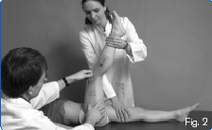
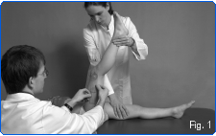
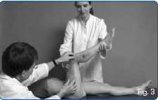

Slide 29
Modified Tardieu
Boyd & Graham 1999
Defines the angle of ROM (R1) Where the ‘catch’ (Tardieu X=3 or X=4) is felt at a fast passive stretch (Tardieu V3)
Angle of ROM with slow stretch (R2)
R2 - R1 = ‘dynamic component’
‘clinical measure of spasticity

Slide 30
Dystonic CP
Hypertonia shows an increase in muscle activity when at rest
Return to a fixed posture
Resistance increases with movement of the contralateral limb, and changes with a change in behavior or posture

Slide 31
There are also involuntary sustained or intermittent muscle contractions causing twisting and repetitive movements, abnormal postures, or both

Slide 32
To distinguish between spasticity, dystonia, and rigidity in the pediatric clinical setting - Hypertonia Assessment Tool (HAT)
The reliability and validity for spasticity and rigidity is good, but only moderate for dystonia and mixed tone

Slide 33
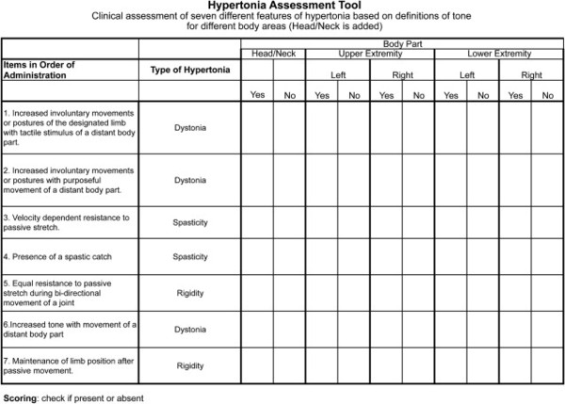

Slide 34
The Barry Albright Dystonia (BAD) scale, a 5-point ordinal scale, is another measure of generalized dystonia

Slide 35
Mixed tone
Identified with a combination of both types of hyper tonicity in the same patient
Mixed tone is more difficult to diagnosis and quantify than pure spasticity
It is important to assess the degree of mixed tone present, because the outcome of surgery may be less predictable

Slide 36
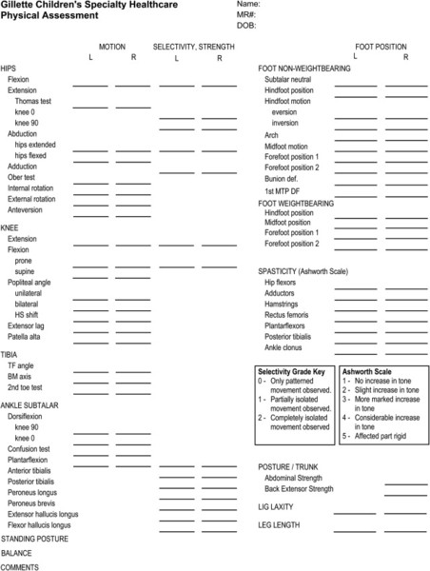

Slide 37
Strength in CP

Slide 38
Muscle testing in CP
Clinicians feared that strong near maximal effort would exacerbate spasticity and muscle tightness in those who were already ‘stiffer’ than normal
(Bobath, 1990)

Slide 39
Weakness - significant impairment in CP?
Strength training effective in increasing force production and improving motor function and disability in CP?
Notes:
Times changed lot of research was done over UMN lesions and advocates of strength training needed scientific methods to demonstrate – was weakness really hampering activities
And whether strength training could actually improve force production
Since then - The assessment of muscle strength in CP has become standard in clinical practice and research

Slide 40
Difficulties performing everyday functional activities
Different distribution of muscle strength
Notes:
Again they were confronted with a problem - When we measure muscle strength with MMT, even if two individuals with CP have similar muscle power , their ability to perform functional activities will be different

Slide 41
Lit. gives two different muscle strength measurements that are used in children and adolescents with CP
Isometric and isokinetic

Slide 42
Isometric
An isometric-based test - measures the ability of a muscle group to produce force without a change in overall muscle-tendon length

Slide 43
clinical practice
Muscle strength is usually assessed by isometric resistance-based methods
manual muscle testing (MMT) and
hand-held dynamometry (HHD)
MMT uses an ordinal 6-point (0 – 5) Medical Research Council (MRC) scale

Slide 44
MMT
MMT using the Kendall scale is the typical method for measuring muscle strength in children with CP
Quick way to assess
Should be used as a screening tool

Slide 45
MMT
Reliability of is fair when assessed for individual muscles
Training is required to achieve this modest reliability
Method is often not sufficiently sensitive to assess muscle strength of MRC grade 4 and grade 5
Notes:
Method is often not sufficiently sensitive to assess muscle strength of MRC grade 4 and grade 5 or to detect small or moderate
increases of strength over the course of rehabilitation

Slide 46
Bias = decrease in the reliability
Examiner’s judgment
Experience
The amount of force generated by the examiner

Slide 47
HDD
HHD consists of a simple hand-held device equipped with a small internal load cell capable of measuring muscular force (in Newton / pound force)

Slide 48
There is no consensus about the way of testing that should be used
Publishes studies used
break-method
make-method

Slide 49
Because of the number of measurements
Protocol - the child was allowed a 5 minute rest between the break- and make-test

Slide 50
Break test
In the break test, the examiner gradually applied force with the dynamometer for 1 sec to allow the to adjust and to recruit the maximum number of muscle fibres.
After 1 sec, the force of the examiner exceeds the force of the patient very slightly

Slide 51
Make Test
Maximal effort exerted against a stationary HHD
Instruction - to gradually ‘push as hard as possible’ against the dynamometer (held rigidly by the examiner perpendicular to the child’s limb segment) over a period of approximately 5 sec until the examiner asks the patient to relax

Slide 52
Damiano et al. suggests that the peak value, achieved in a series of trials during the make-method, should be used to measure muscle strength in children with CP
Notes:
But I personally feel both the methods are relevant depending on what u are measuring - if u are measuring torque at the joint – make method

Slide 53
Standardized muscle test positions

Slide 54
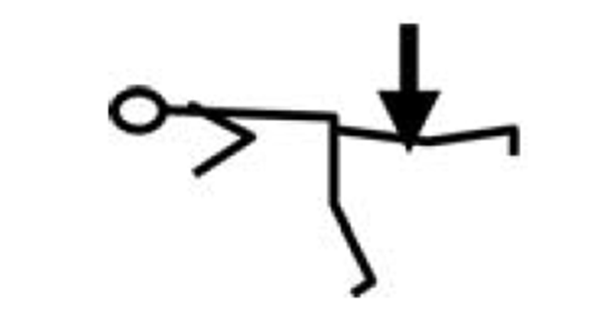
Hip extensors -1
Subject position- Prone with legs outside the couch - not tested with foot on the floor
Stabilization – hold on the bench
Resistance – femur distally
Lever arm measurement – from GT

Slide 55
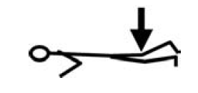
Hip extensors -2 ( where isolation is possible )
Subject position- Prone
Stabilization – hold on the bench
Resistance – femur distally
Lever arm measurement – from GT

Slide 56

Hip flexors -1
Subject position- Sitting
Stabilization – hold on the bench
Resistance – femur distally
Lever arm measurement – from GT

Slide 57

Hip flexors -2
Subject position- Supine (Hip and knee flexed 90°)
Stabilization – hold on the bench
Resistance – femur distally
Lever arm measurement – from GT

Slide 58
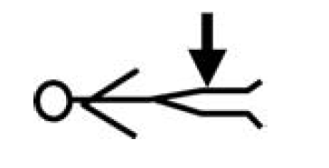
Hip abductors
Subject position- Supine (Hip and knee extended)
Stabilization – hold on the bench, stabilize other leg
Resistance – femur distally
Lever arm measurement – from GT

Slide 59

Hip adductors
Subject position- Supine (Hip and knee extended)
Stabilization – hold on the bench, stabilize other leg – not tested knee flexed
Resistance – femur distally
Lever arm measurement – from GT

Slide 60
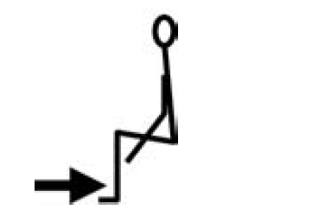
Knee extensors
Subject position- Sitting
Stabilization – hold on the bench
Resistance – shank distally
Lever arm measurement – Lateral
knee joint

Slide 61
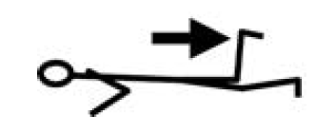
Knee flexors 2
Subject position- prone , knee flexed 90 deg
Stabilization – hold on the bench
Resistance – shank distally
Lever arm measurement –
Lateral knee joint

Slide 62
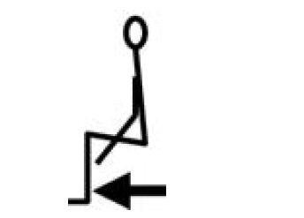
Knee flexors 1
Subject position- Sitting
Stabilization – hold on the bench
Resistance – shank distally
Lever arm measurement –
Lateral knee joint

Slide 63
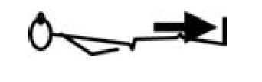
Ankle dorsiflexors
Subject position- Supine , hip knee extended, ankle 0 deg.
Stabilization – hold on the bench
Resistance – dorsum of foot
Lever arm measurement – Lateral malleolus

Slide 64
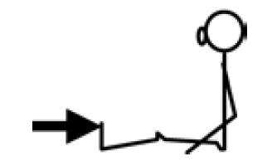
Ankle plantar flexors
Subject position- Sitting , knee extended
Stabilization – hold on the bench
Resistance – meta tarsal heads
Lever arm measurement – Lateral malleolus

Slide 65
Isokinetic

Slide 66
Isokinetic
Isokinetic literally means ‘same velocity’ and refers to tests that are performed at a predetermined constant velocity
Prefers torque measurement

Slide 67
Most often used in a laboratory setting
Uses computer-controlled equipment to measure the muscular force generated throughout a controlled movement
Advantageous over isometric measurements

Slide 68
Most activities of daily living involve phases of dynamic muscle action, and in this sense isokinetic testing may provide more specificity in terms of muscle action type than isometric testing

Slide 69
A maximal isometric contraction is only indicative of the capacity to produce force in that condition and at that particular muscle length, and
Can not necessarily be extrapolated to conditions where the muscle length is different or changing throughout the task
Notes:
But we know that both the systems of measurement cannot replicate the strength testing , because both occur in non functional states
We know that different joing ts have got different torque requirements for various functional activities

Slide 70
RM testing / functional test

Slide 71
HHD measures muscle strength in a single joint movement
The functional strength tests are more related to the activity level and consist of multiple-joint movements

Slide 72
An alternative approach to measure muscle strength in a dynamical way is the use of the Repetition Maximum (RM) during functional exercises
Notes:
When all the exercises are functional why not the strength measurement be functional , in the pattern of activity

Slide 73
Since many lower extremity training and rehabilitation programs have been centred on functional exercises
The RM during functional strength tests, based upon the specificity of training principle, may be better suited to detect actual improvements in lower extremity performance

Slide 74
Functional strength tests may be used in two ways
Assess lower extremity performance are by counting the number of repetitions performed at a specific activity over a specific period of time
By assessing the time necessary to complete a specified number of repetitions at a specific activity

Slide 75
Be Cautious in using the second approach
Bear in mind – functional diversity in CP
Assessing time to perform fixed no. of rep may not be a good idea
We want all of them to complete the test!
Notes:
So counting the numbers of repetitions performed over a specific period of time seems the most appropriate
Using this method all the children will be able to complete the test

Slide 76
Functional strength tests not only measure muscle strength, but also balance, coordination and some endurance and therefore correspond with the contemporary task-oriented approach

Slide 77
To assess functional performance in children with CP we chose functional exercises in which the large muscle groups that are important for standing and walking are being tested

Slide 78
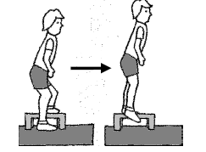
The Lateral Step-up Test
Step ht. - 20 cm bench

Slide 79
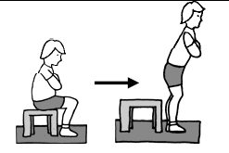
Sit-to-Stand

Slide 80
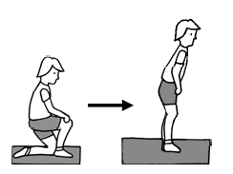
Attain stand through half kneel

Slide 81
Step ups

Slide 82
Kneel sit to stand

Slide 83
Toe stands

Slide 84
Selective motor control

Slide 85
SMC
ability to isolate and control movements

Slide 86
SMC
Without SMC assessment strength assessments are confounded
Impaired SMC contributes to ambulatory and functional motor deficits
Assessment of SMC involves isolating movements on request

Slide 87
Note - SMC
Appropriate timing
Maximal voluntary contraction without overflow movement
A typical scale for muscle selectivity reports 3 grades of control: 0, no ability; 1, partial ability; and 2, complete ability to isolate movement

Slide 88
E.g. – hemiplegic CP
Range | MMT - DF | SMC - DF | Impairment list Stance By VGA | Impairment list Swing By VGA | Inference
+ 20 deg. | 3/5 | 0/2 | Initial drag / reduced foot clearance |  | timing is late and the motion is not controlled
No surgical treatment would be able to address the problems of timing and balance
An orthotic may be the more appropriate recommendation
Problems of timing and balance – only AFOs/ assistive devices should be used

Slide 89
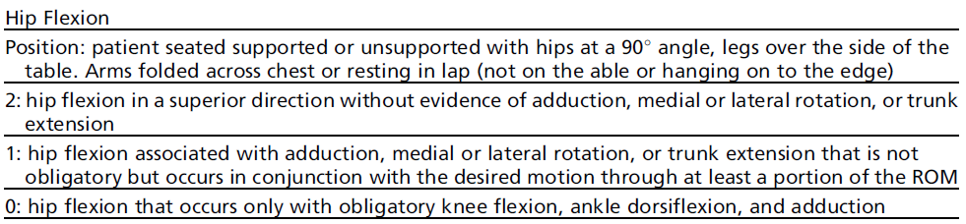
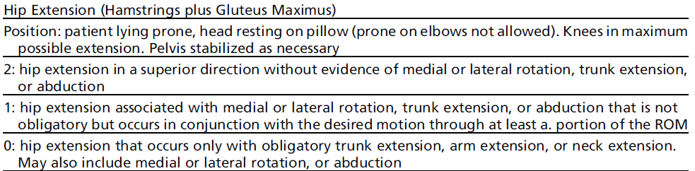

Slide 90
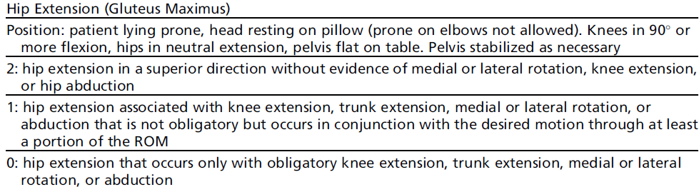
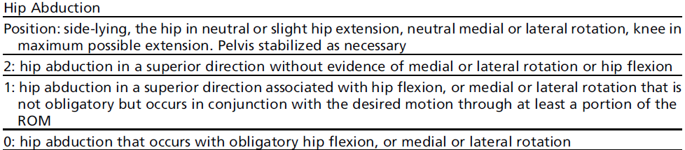

Slide 91
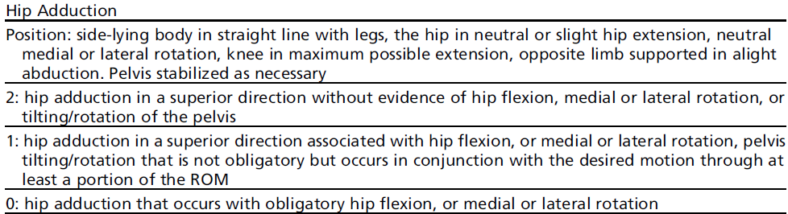
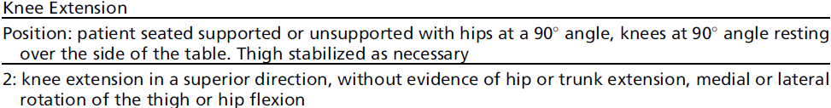
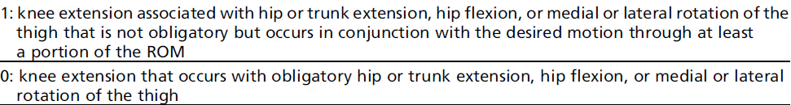

Slide 92
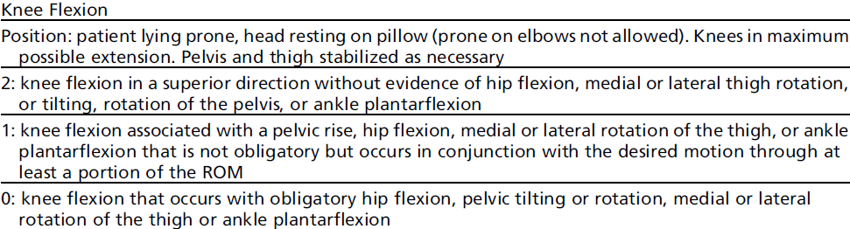
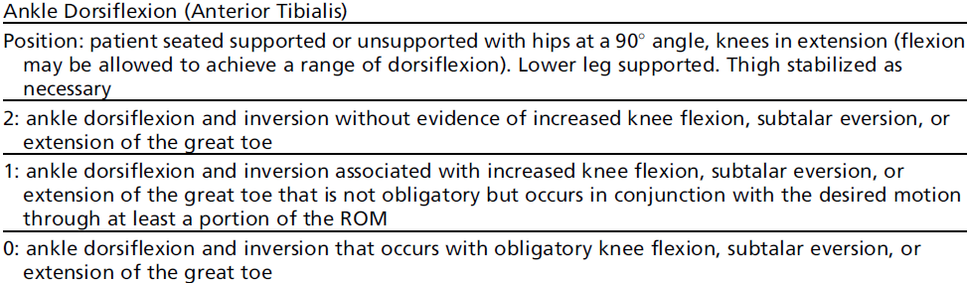

Slide 93
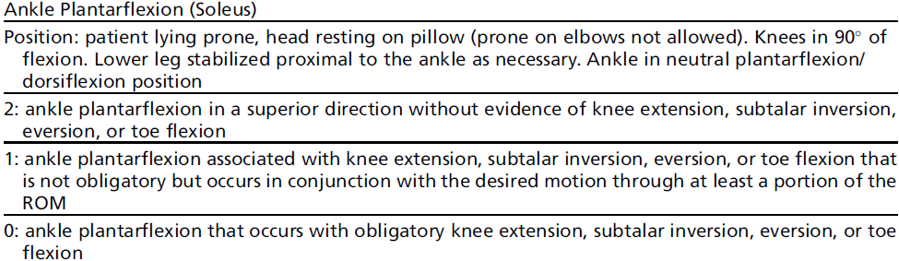
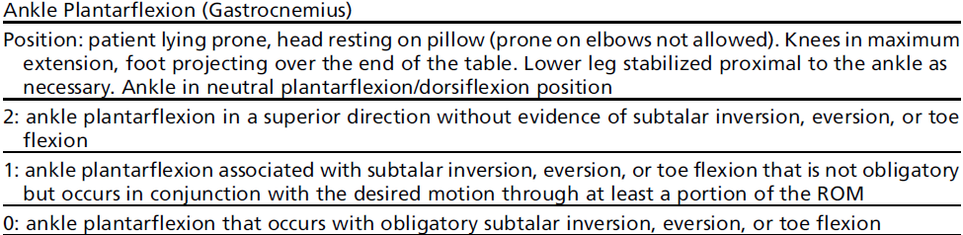

Slide 94
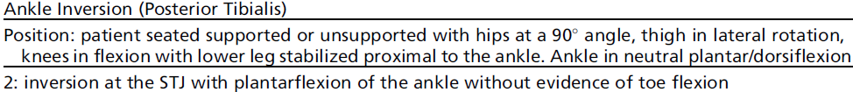
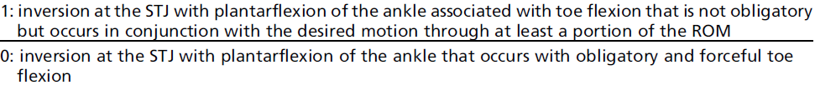
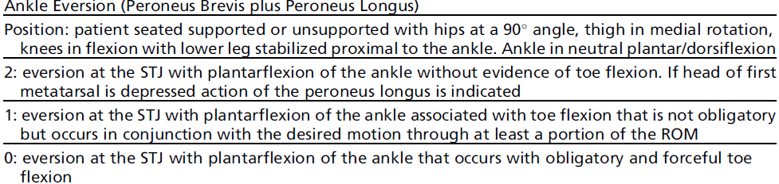

Slide 95
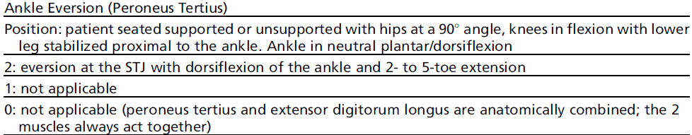
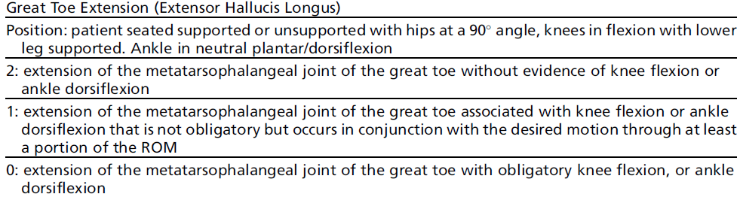

Slide 96
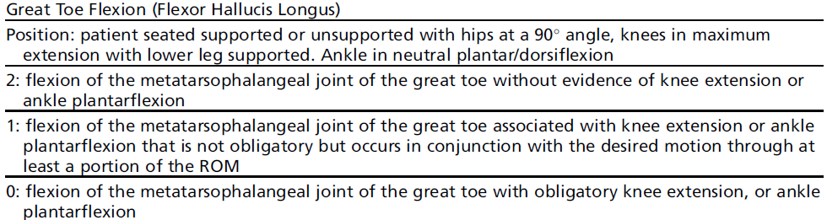

Slide 97
ROM and Flexibility testing in CP

Slide 98
Differentiate between static and dynamic contractures
Carry out ROM assessment very slowly
Differentiation between contracted bi-articular and monoarticular muscle is important

Slide 99
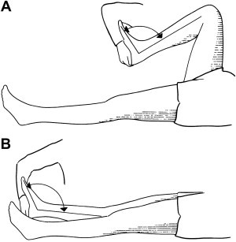
Sliverskiold Test – soleus length
To differentiate between gastrocnemius and soleus contracture

Slide 101
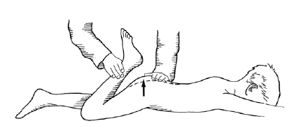
Duncan Ely test – rectus femoris length
Differentiates between contracture of monoarticular Vastii and bi articular Rectus femoris

Slide 102
Psoas Length
To measure degree of hip flexor tightness
Pat. In supine position and pelvis held such that ASIS and PSIS are aligned vertically
Defining the pelvic position consistently rather than using the flattened lordosis improves reliability

Slide 103
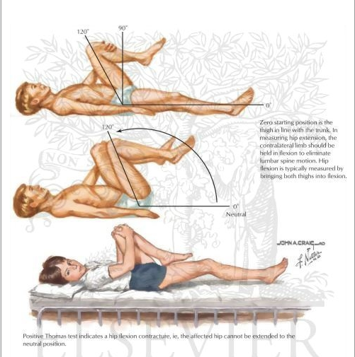

Slide 104
Knee
Knee flexion contracture can be caused by 4 components
Shortened hamstrings
Shifted hamstring due to excessive anterior pelvic tilt
Shortened proximal gastrocnemius
Capsular contracture

Slide 105
Hamstring length (unilateral popliteal angle)
Position - resting supine – contralateral hip flexed – ipsilateral hip flexed to 90 deg.
The knee is extended until first endpoint of resistance is felt
Measure the degrees lacking from full extension will give connective tissue and resting muscle extensibility

Slide 106
Hamstring length (True/bilateral popliteal angle )
Position – ipsilateral hip flexed to 90 deg – contralateral hip flexed until ASIS and PSIS are aligned vertically
If there is a significant Hamstring shift the popliteal angle will significantly decrease as the pelvis is tipped posteriorly

Slide 107
“Hamstring shift”
Calculate unilateral popliteal angle [flatten lordosis] – functional hamstring contracture
Calculate bilateral popliteal angle [ neutral pelvis ] – true hamstring contracture
Find out the difference between the two = degree of hamstring shift

Slide 108
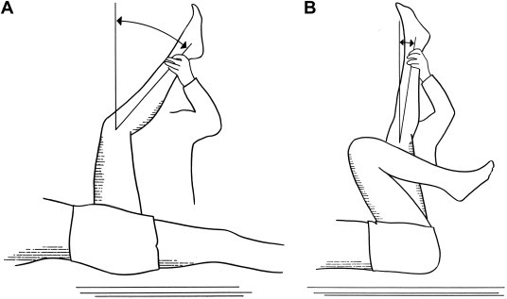

Slide 109
Excessive anterior pelvic tilt is common in SDCP and QCP
Excessive anterior pelvic tilt will produce Hamstring shift with AN APPARENT KNEE FLEXION CONTRACTURE

Slide 110
In children with crouch gait
Hamstrings length is frequently normal or long
Surgical lengthening of hamstrings often serves to produce further weakening of hip extension and exacerbates the excessive length of hamstrings
Result - Additional hip flexion, anterior pelvic tilt and lumbar lordosis

Slide 111
Every 1 deg. of excessive pelvic lordosis – 2 deg. increase in knee flexion
A hamstring shift of > 20 deg. – indicates
excessive anterior tilt [tight hip flexor]
excessive anterior tilt [Weak abdominals]
excessive anterior tilt [Weak hip extensors]

Slide 112
Normal popliteal angle measurement for - 5-18 yr. old – 0 – 49 deg. (mean 26 deg.)
50 deg. popliteal angle would be considered as mild deviation

Slide 113
Bone deformity

Slide 114
Femoral anteversion
Relationship between the axis of the femoral neck and the femoral condyles in the transverse plane
Femoral anteversion is reported as the difference between the tibia and the vertical

Slide 115
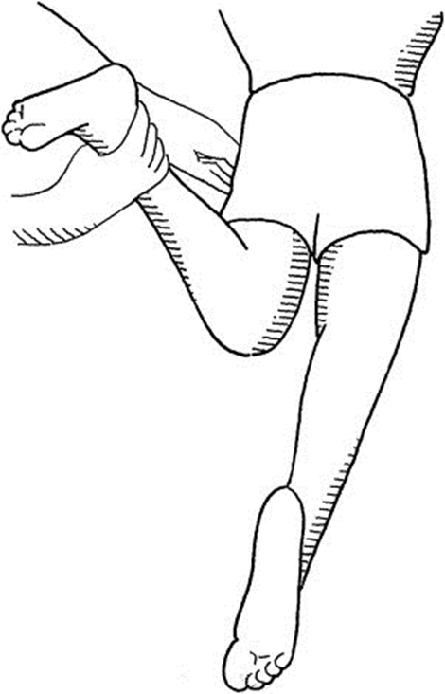

Slide 116
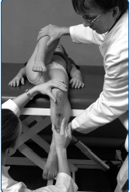
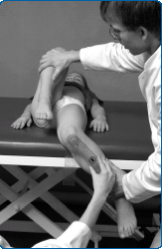
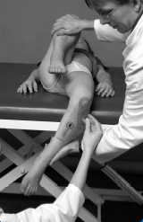

Slide 117
Tibial torsion
Thigh-foot angle - most reliable because it is most commonly used
It is difficult to standardize foot alignment, and foot deformities are common in children with CP
Through knee joint transverse plane rotation can also be inadvertently introduced.

Slide 118
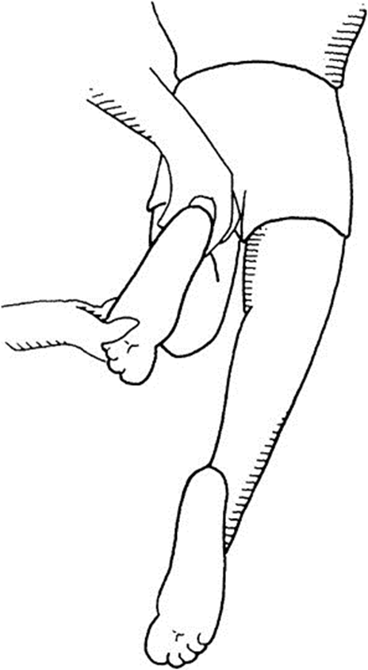
Flex the knee to 90°,
Position the hind foot vertically,
Dorsiflex the ankle to 90° with the foot in subtalar neutral position
Place the proximal arm of the goniometer along posterior axis of femur and the distal arm along the bisector of the hindfoot and the point between the second and third metatarsal heads

Slide 119
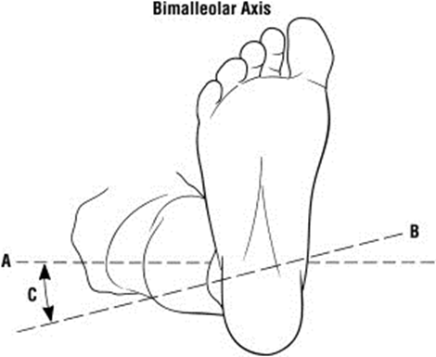
Used in cases of rigid foot deformity
With the knee fully extended in the supine position rotate the thigh segment until the medial and lateral femoral condyles are horizontal.
Mark the midpoints of the medial and lateral malleolus
Using a goniometer measure the angle between the bimalleolar axis and the condylar axis

Slide 120
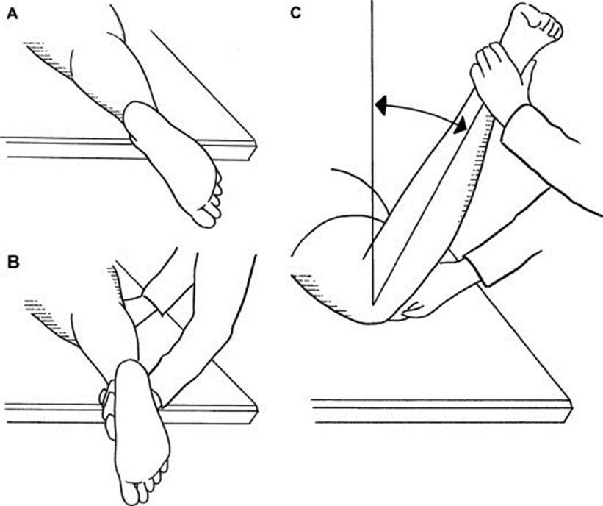
Second toe test
External tibial torsion leads to an outwardly pointed foot when the patient is relaxed in the prone position with the knee fully extended
Rotate the leg to position the second toe pointing directly toward the floor (in this case requiring internal hip rotation)
Hold the thigh in this position (preventing internal or external hip rotation) as the knee is flexed
Measure the angle from vertical

Slide 121
Patella Alta and knee extensor deficiency
Patella alta occurs to chronic excessive knee extensor forces of rectus femoris spasticity and crouch gait
Extensor lag is measured with the patient positioned supine (to relax the hamstrings), and the leg flexed at the knee over the end of the examination table

Slide 122
SAROMM

Slide 123
Activity capacity measurement - GMFM

Slide 124
Gross motor function
A skilled set of motor activities performed as a part of normal developmental milestones which can be delayed or disordered
Ability of children to carry out activities that require large muscles or groups of muscles. Muscles or groups of muscles should act in a coordinated fashion to accomplish a movement or a series of movements

Slide 125
Fine motor function
Movements of small muscles that act in an organized and subtle fashion, for instance, the hands, feet, and muscles of the head (as in the tongue, lips, facial muscles), to accomplish more difficult and delicate tasks

Slide 126
GMFM
Clinical measure designed to evaluate change in gross motor function in children with CP
Set of parameters that relate to motor development
Many versions including a parent reported questionnaire
Applicable 2-18 years

Slide 127
This measure gives a numerical score and is useful as a general measure of children’s balance, motor control, and motor planning
Best describe gross motor function in children with cerebral palsy of varying abilities

Slide 128
Commonly used - baseline profile
Detect change in gross motor function
Correlation to muscle performance
Time-distance components of gait

Slide 129
How frequently should the GMFM-66 be administered
Considerations include, but are not limited to:
age (more frequent evaluations in younger children)
type and intensity of intervention over a specified period of time (pre- and post evaluations around interventions that are expected to make a difference)

Slide 130
estimate of the amount of time that the child will require to learn a gross motor function(s)
concurrent health status (evaluation around the time the child experiences other health concerns to establish the impact on gross motor function)

Slide 131
a facility’s administrative requirement for an annual evaluation
responsiveness of the GMFM-66
GMFM-66 is more sensitive to change at the extremes of the scale (i.e. for those children scoring very low and those scoring very high)

Slide 132
How much improvement
The overall magnitude of change in GMFM-66 score that is considered “clinically important” has not been determined scientifically
But the therapist can use their clinical judgment to determine if the items showing improvement are clinically important for the child they are seeing

Slide 133
Energy expenditure - EEI

Slide 134
Energy expenditure - EEI
Protocol –
Child should be able to walk for at least 5 minutes
No eating one hour prior to testing
Resting HR in supine
Child walks on figure of 8 marked walkway
Calculate working HR (HR at the end of 5 minutes for 15 sec*4)
EEI = (Working HR- Resting HR)/ Speed (m/min)

Slide 135
Functional outcome measures

Slide 136
ICF components and measures
ICF components | Variables | Measures
Participation | Performance in daily life activities | LIFE- H, IADL,
Environmental Factors | Type and extent of modifications Impact of modifications | TERRAINS PEDI: Modifications scale Likert scale MQE
Personal Factors | Gestational age Age | Questionnaire

Slide 137
To evaluate child’s skills in community
FMS
PODCI
FAQ

Slide 138
FMS - is an evaluative measure
Used for aged 4-18
Quantifies functional mobility at both activity level and participation domains of ICF
Ability to distinguish between assistive devices and the environmental setting they use in
FMS has shown sensitivity to quantify change after orthopedic intervention in children with CP

Slide 139


Slide 140
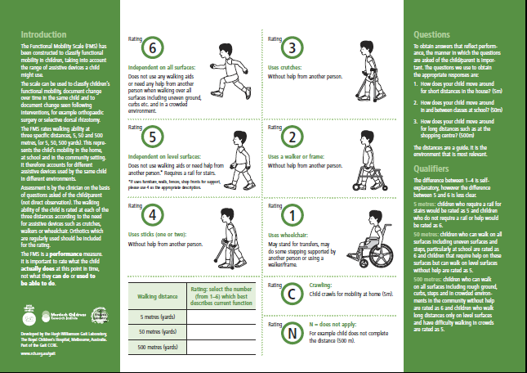

Slide 141
PODCI
Major goal for orthopaedic interventions in this population is to improve the functional health of the patients and, in particular, physical function
The PODCI serves to provide a quantified perception of function by the parents or caregivers and the CHILD

Slide 142
Measuring and Enhancing Quality of Life of Children and Adolescents with Cerebral Palsy

Slide 143
Measuring…
Enhancing…
Quality of Life…
Children…
Adolescents
What are We Trying to Achieve?

Slide 144
Lets re- arrange
Quality of Life…
Enhancing…
Measuring…
What are We Trying to Achieve?
Children…
Adolescents

Slide 145
WHO defines QoL as:
“the individual’s perception of their position in life in the context of the culture and value systems in which they live, and in relation to their goals, expectations, standards and concerns”
What do you think - definition?!!!

Slide 146
Let’s look again
WHO defines QoL as:
“the individual’s perception of their position in life in the context of the culture and value systems in which they live, and in relation to their goals, expectations, standards and concerns”

Slide 147
‘Health-related’ implies that we are interested in the impact of the condition on the person and on their ‘QoL’
In effect, HRQoL equates Functional Status and Quality Of Life

Slide 148
Whose perspectives can you think of?
The person themself
A parent or other outside (‘proxy’) observer
A health professional (which ones, and does it matter?)
A ‘community’ perspective

Slide 149
HRQoL tools
  SF-36 or SF-12 – measures of adult function
  PedsQL – mainly looks at emotional status

Slide 150
To choose the right measure(s), whether for research or for clinical evaluations, we need to ask:
What’s the question?

Slide 151
